Slide 1
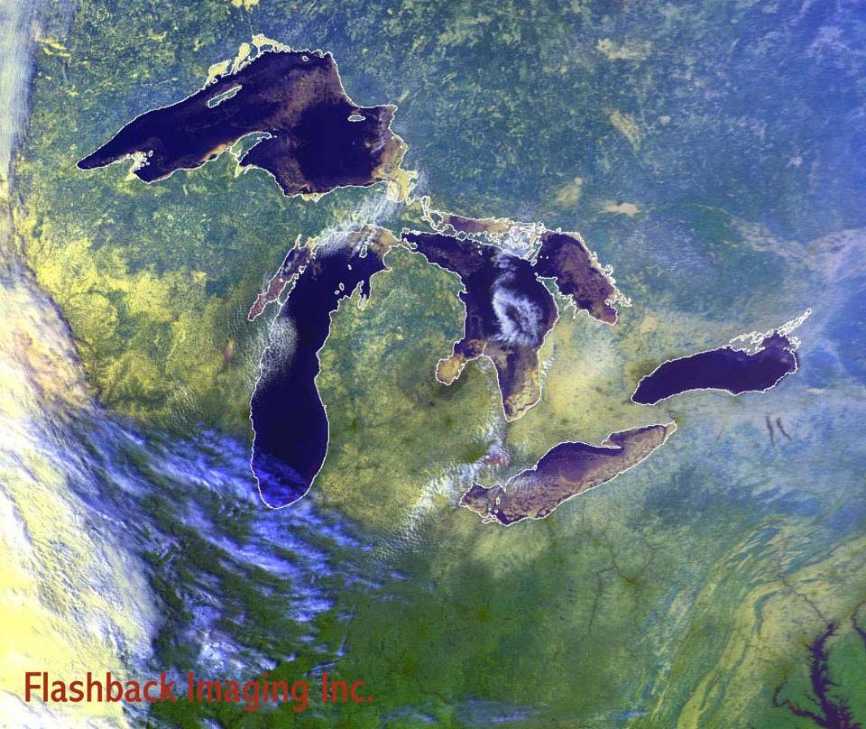
Isle Royale
Notes:
Isle Royale, or ile-ROY-ul as most Midwesterners pronounce it, is the largest island in Lake Superior.

Slide 2
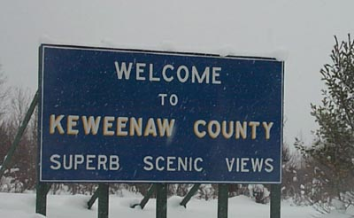
Notes:
Located in beautiful Keweenaw county …

Slide 3
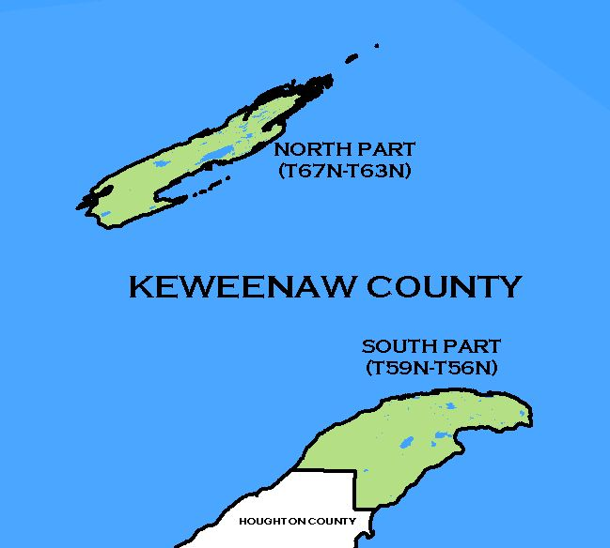
Notes:
… whose two parts complete the geologic structure of which Isle Royale is half. More on that later.

Slide 4
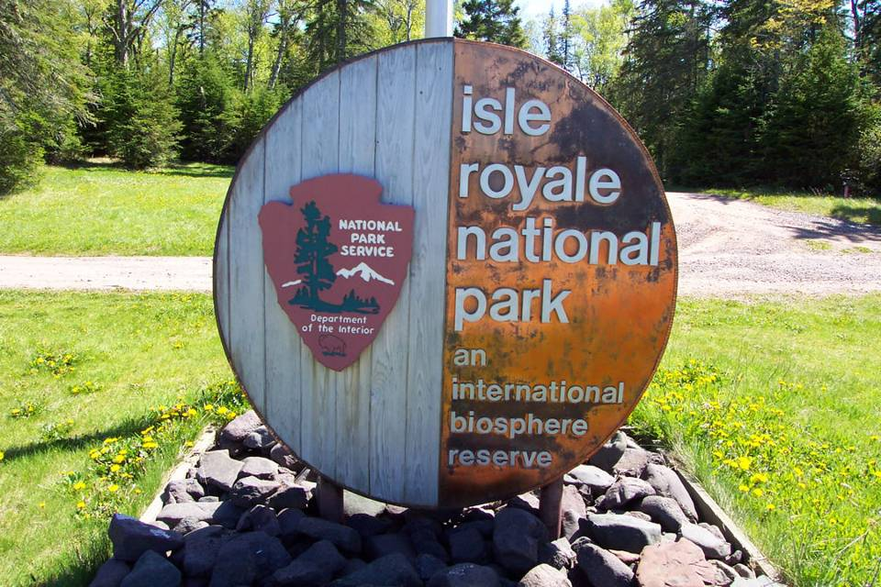
Notes:
The park’s entrance sign hints at some of its features. On the left is some kind of wood, for the island is covered with spruce, birch and cedar. On the right is a copper veneer that tells of the abundant copper deposits in the area. That the sign is shaped like a wheel is perhaps a bit of irony, because as an international biosphere reserve, absolutely no wheeled vehicles of any kind are allowed on the island.

Slide 5
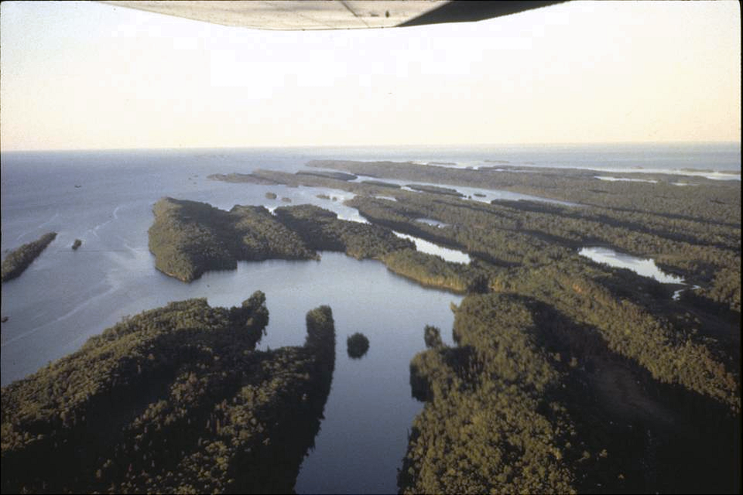
Notes:
Hiking and boating are about the only way to get around. Mostly that’s because of park policy, but the island’s topography is not wheel-friendly either.

Slide 6
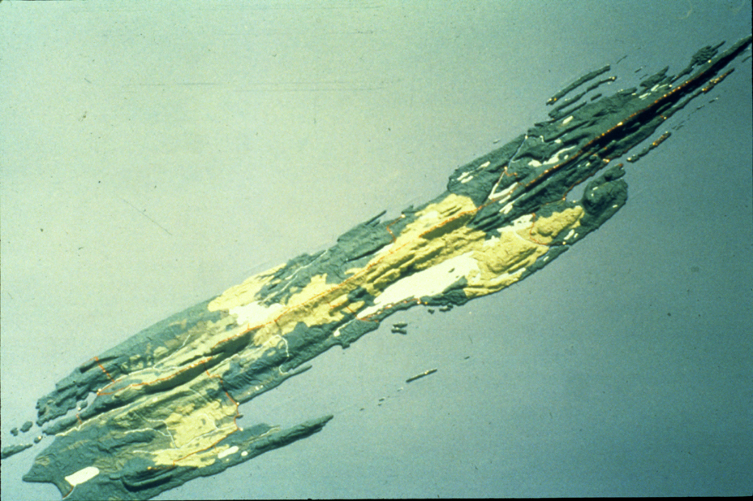
Notes:
Isle Royal’s uniquely elongated ridges are the product of mostly glacially-caused differential erosion of …

Slide 7
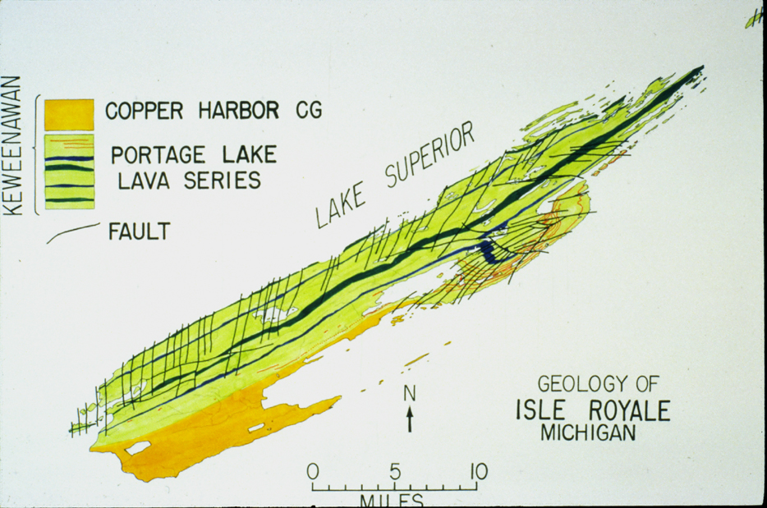
Notes:
… a Proterozoic sequence of interbedded lava flows and associated sedimentary rocks. Ridges correspond to layers of particularly resistant basalt.

Slide 8
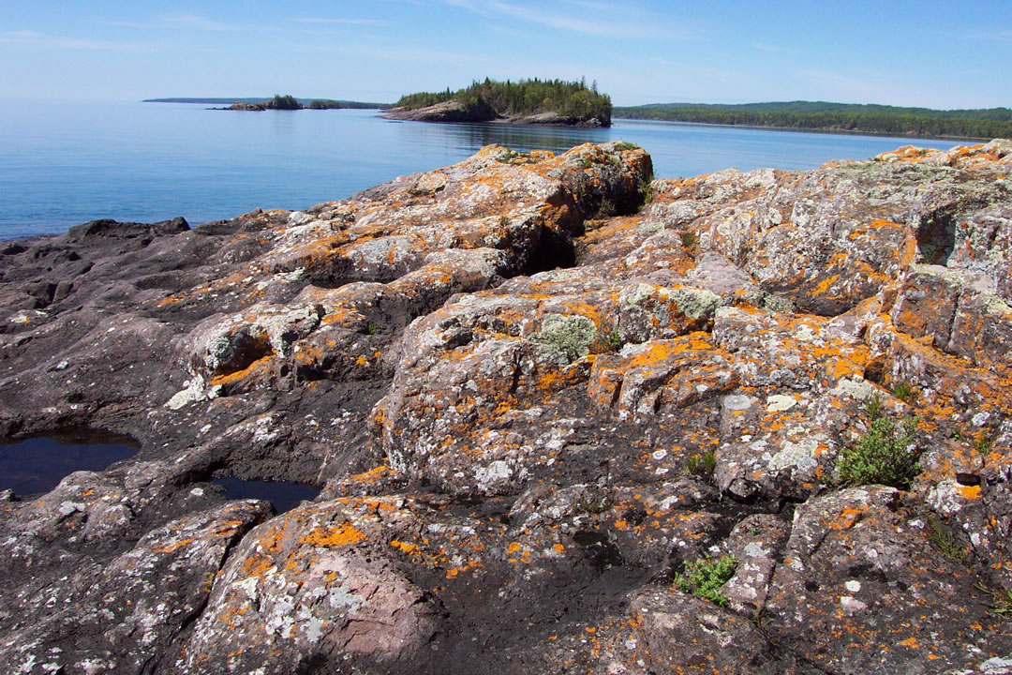
Notes:
Along the shorelines where wave erosion outpaces soil formation …

Slide 9
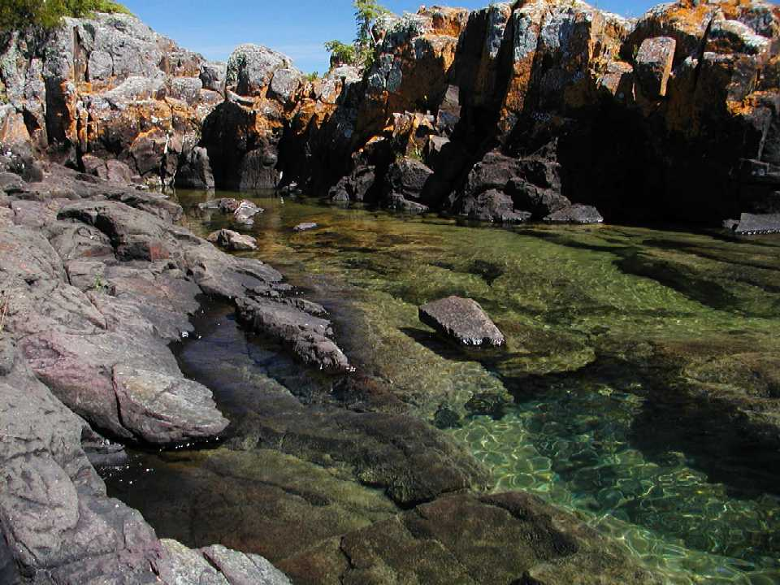
Notes:
… the black, fine-grained basalt is visible.

Slide 10
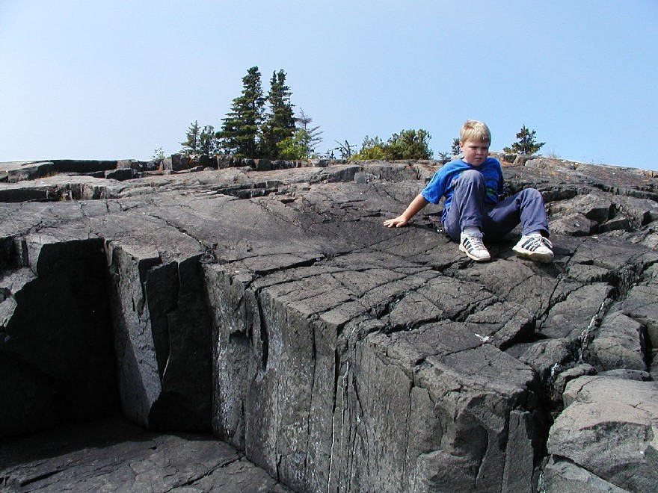
Notes:
Good outcrops also occur where glacial erosion was most severe – like on the ridge crests where the most erosion-resistant basalt occurs. These basalts formed as extremely fluid lava flows that spread laterally over vast areas.

Slide 11
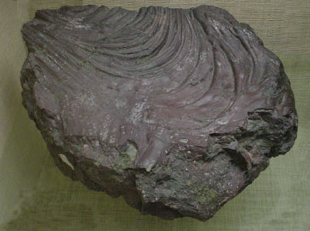
Pahoehoe
Flow direction
Notes:
The wrinkled surface of this ancient lava flow from Isle Royale bears witness to the fluidity of the lava. Known as pahoehoe, such lava forms when a thin, partly-solidified lava skin is stressed by the flow of highly fluid magma beneath.

Slide 12
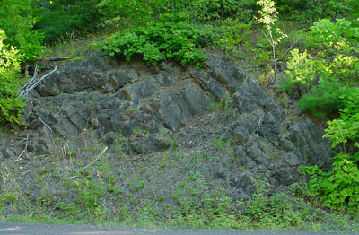
Columnar basalt
Notes:
Columnar basalt also testifies to the lava’s fluidity. Fluid lava spreads-out evenly over vast areas, so when cooling occurs, contraction is uniform and internal. The process is much like how a layer of dried mud cracks, only a lava flow is much thicker, so the deeper cracks form columns.

Slide 13
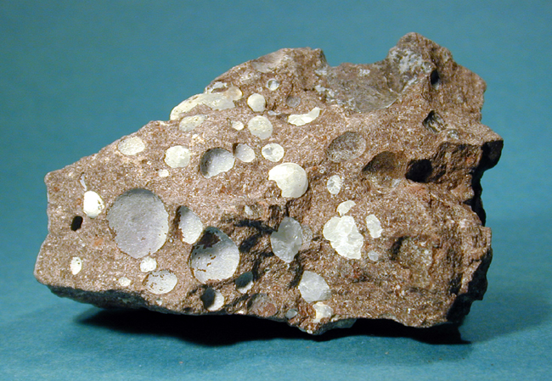
Amygdaloidal Basalt
Notes:
Between the elongated ridges, more easily eroded amygdaloidal basalt is found.

Slide 14
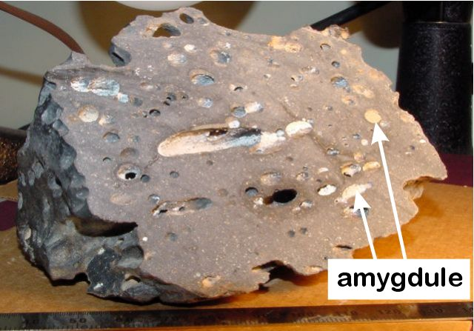
Notes:
Amygdules refer to gas bubbles (vesicles) that have been filled with minerals.

Slide 15
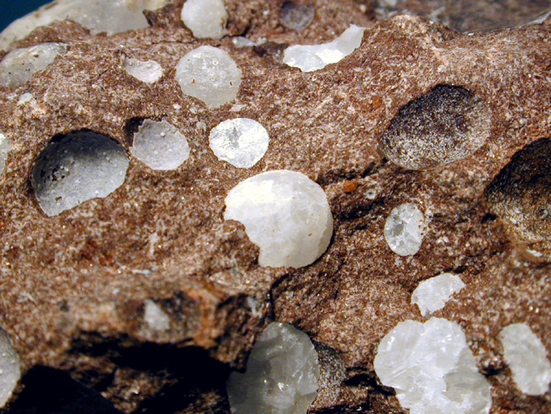
zeolites
Notes:
The minerals filling the vesicles are typically some type of zeolite, which refers to a group of hydrous aluminosilicate minerals. Zeolites have an interesting list of uses that includes being the main component in water softeners. Often the zeolites are more resistant to weathering than the surrounding basalt, …

Slide 16
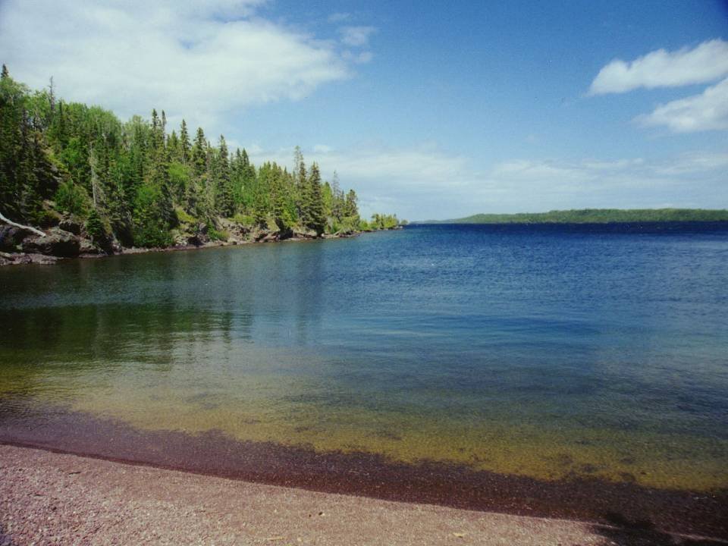
Notes:
… so some of the island’s beaches are made of abundant amygdule pebbles …

Slide 17
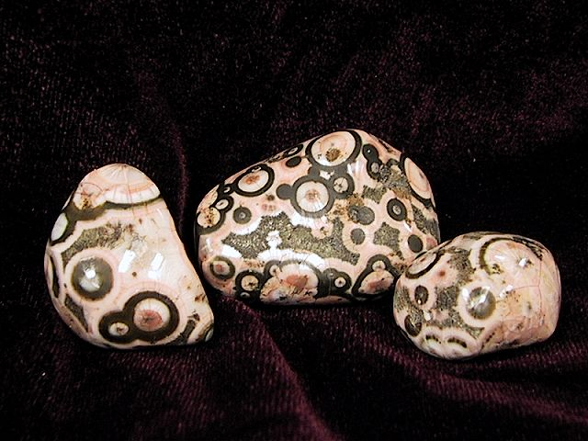
The zeolite “Thompsonite”
Notes:
… like these beauties comprised of the rare mineral Thompsonite.

Slide 18
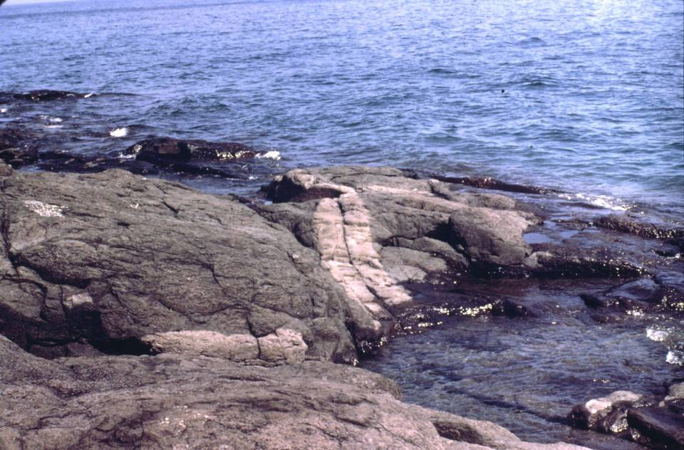
Basalt + felsic intrusives = bimodal magmatism
Notes:
Locally there are felsic dikes intruded into the basalt. The combination indicates bimodal magmatism, which is an important indicator of the tectonic environment in which these rocks were formed.

Slide 19
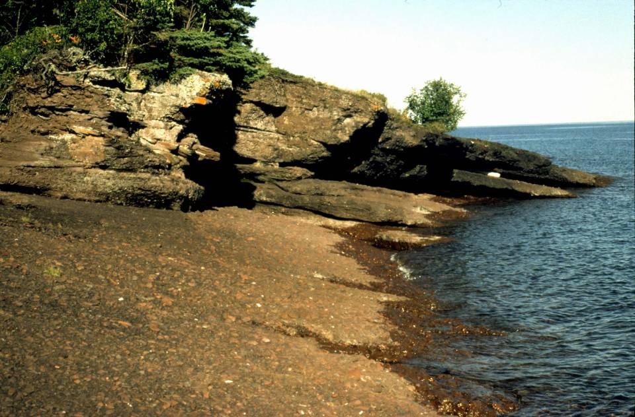
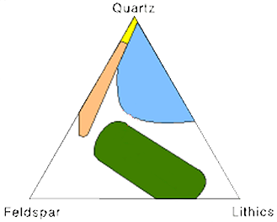
Copper Harbor Conglomerate
Notes:
Also indicative of that environment are the island’s sedimentary rocks. The most notable of these, the Copper Harbor Conglomerate, is relatively feldspar rich. That, combined with the bimodal volcanism, should give you a pretty good idea as to the tectonic environment.

Slide 20
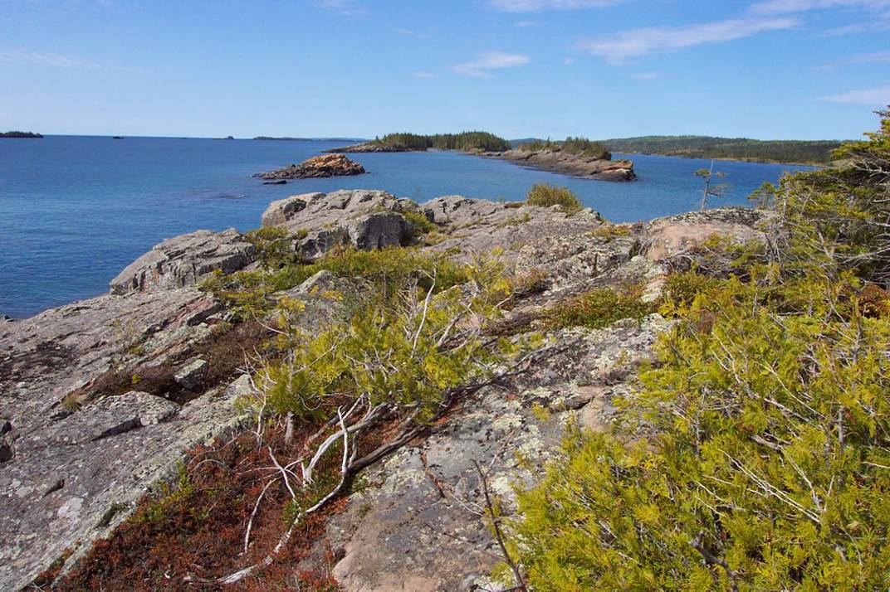
SE
NW
SE Dip direction
Notes:
But let me add one more piece to the puzzle – geologic structure. Lava flows and sedimentary rocks on the island all have a consistent southeast dip direction.

Slide 21
Dip direction
Notes:
Note also that Copper Harbor Conglomerate outcrops on the southeastern side of the island and that the southeasterly dip of these rocks is toward …

Slide 22
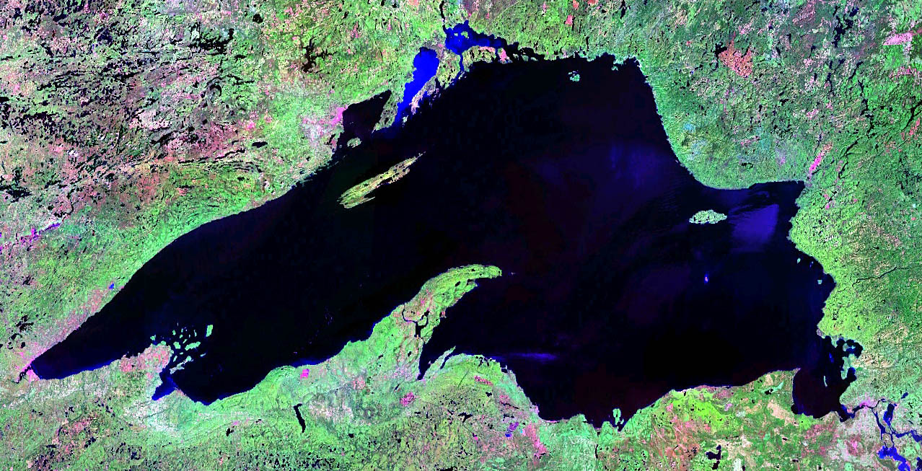
dip
Keweenaw Peninsula
Notes:
… the Keweenaw peninsula.

Slide 23
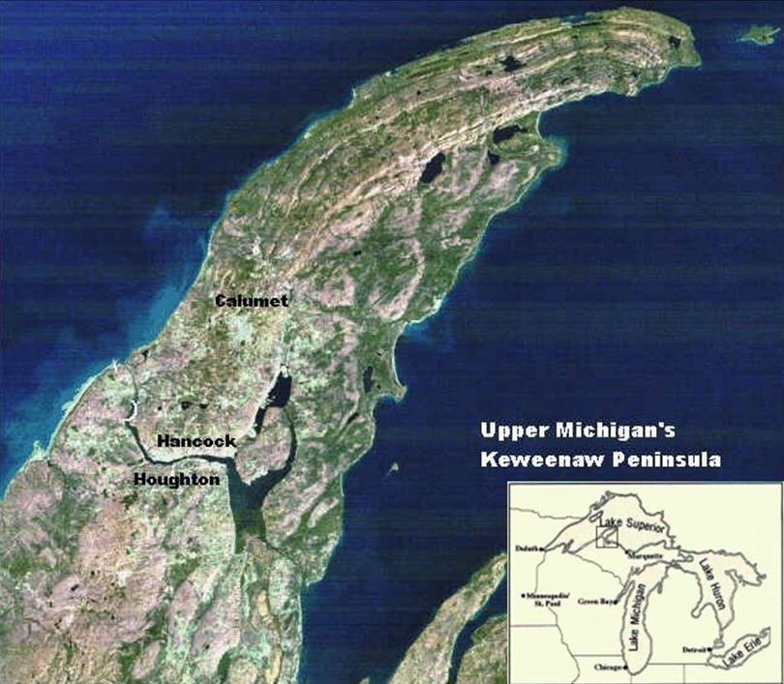
dip
Copper Harbor Conglomerate
Portage Lake Volcanics
Notes:
The same rock units that occur on Isle Royale occur on the Keweenaw Peninsula, where their order and dip direction is reversed.

Slide 24
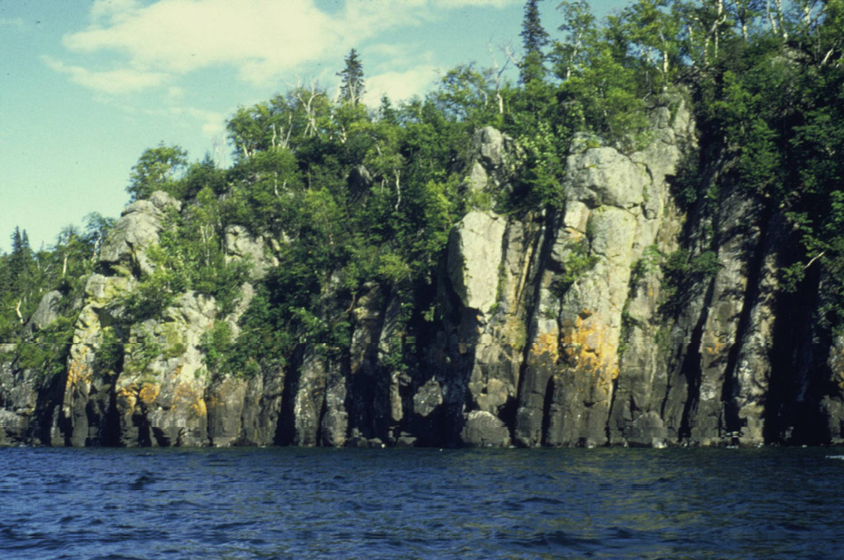
Dip direction
Notes:
Furthermore the peninsula rocks dip more steeply than those on the island.

Slide 25
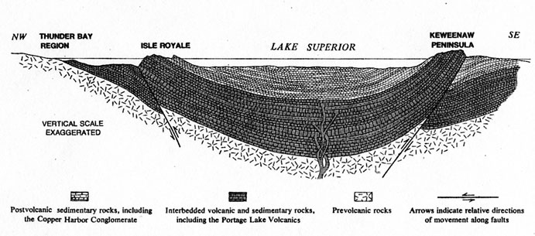
Notes:
Putting it all together now in this cross section, you can see that Isle Royale and the Keweenaw Peninsula are two sides of a giant downward fold called a syncline. The syncline is slightly asymmetrical because the rocks at Keweenaw dip more steeply. The syncline and associated reverse faults formed by compression during the Proterozoic Grenville Orogeny.

Slide 26
Pre-Grenville structure
Notes:
Removing the effects of Grenville compression returns the structure to its configuration during the time when the volcanic and sedimentary rocks were deposited. You can see that the compressive episode made reverse faults out of what were originally normal faults. This structure should look pretty familiar to you by now.

Slide 27
What tectonic situation do these rocks and structures imply?
Notes:
OK now, put it all together, bimodal magmatism and feldspar-rich sedimentary rocks all forming within a basin bounded by normal faults …. What does it all suggest?

Slide 28
Stage B – Hot Spot Rifting
Notes:
I know you probably had the answer back at bimodal magmatism, but it was fun to show that all the classic features of continental rifting are found at Isle Royale.

Slide 29
Pre-Grenville structure
Notes:
The reason why the synclinal structure existed to some extent before the Grenville compression affected the region, …

Slide 30
Notes:
… is that following the outpouring of huge amounts of lava, the mantle magma source became somewhat evacuated, which combined with the weight of the thick lava flows…

Slide 31
Notes:
… resulted in the subsidence of the basin and subtle down warping of the lava flows. During lulls in volcanic activity feldspar-rich gravels would get carried into the basin from the erosion of the continental rocks bordering the basin.

Slide 32
Notes:
Another batch of fresh magma from the hot spot erupts and the cycle starts over again.

